Slide 1

K18X001.00 Control Run Test Yield Rate
Prepare by: PE- Phuong
Date: Dec 27th 2021

Slide 2
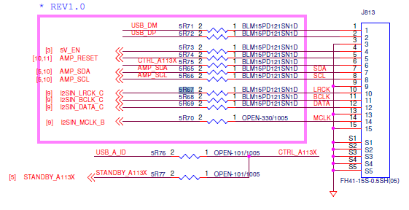
Control Run Content
1. Background Information :
- Control run change 5R67, 5R68 of 96.1531T00 main from 200ohm (PN: 251.00654.005) to 51ohm(P/N: 251.00037.005).
- Quantity: 100pcs.
- Note: Because 251.00037.005(MPN: RC0402JR-0751RL) no stock so use UB25-00984-01(MPN: RC0402JR-0751RL) for this time.
No # | Location | Before change | After change
1 | 5R67, 5R68 | P/N: 251.00654.005 200 ohm | P/N: 251.00037.005 51 ohm
2. Purpose:
Need control run to solve audio noise issue at Customer FW. And remove power on/off station.

Slide 3
Control Run Procedure
Process as below:
K18X001.00
- LINK => BT => PT => UP => Burnin (6 minutes)=> ASSY2 ( Assy with 96.1531T00/.00 control run) => ASSY3 => ASSY4 => FT1 => FT2 => FT3 => RC => Burning (6 minutes) => Power on/ off (on 3 minutes / off 30s)*50 times => RC1 => OBA => RC2 => VI => Packing => FG
96.1531T00/.00 (Change material for 2 locations: 5R67 and 5R68 ).
- Kitting => SMT => AOI => X-ray(100%) => PTH => LINK => UK update AMP version: 0x32 (offline) => remark( Tested UK)=> Link and Assembly into K18X001.00 product
Step | Items | Contents | Remark
1 | Kitting | Provide material to do control run
2 | SMT | Surface mounting technology | Check first PCB to make sure control run material
3 | AOI | AOI 100% PCBA before and after Re_flow | Make sure none process issue
4 | X-ray | X-ray 100% | Take X-ray 100% to check solder short
5 | PTH | Paste through hole | Check VI material polarity
6 | FATP | Test function at Factory FW. | Check if has audio noise NG board, confirm symptom & FA report.
7 | Power on/off | 100% power on /off 50times (on : 3 mins/ off : 30 seconds) ➔ Focus on audio noise issue.
8 | OBA ( 100%)➔ RC2➔ VI➔ Packing➔ FG | Check function of products

Slide 4

Test Yield Rate
OTT |  |  | Model Name | K18X001.00
 |  |  | Quantity | 100pcs
 |  |  | AMP board image | 0x32
 |  |  | Production image | v522r13e_fac-20210914
 |  |  | Customer image | QT.19.531.20
 |  |  | MO | 2643000876
 |  |  | Date | 12/24/2021
1.Product Yield & FA Report
Customer | Product Model | Test Station |  | Yield Rate | Statistical | Yield Rate
OTT | K18X001.00 | BT |  | 100.00% | Total | 100
 |  |  |  |  | Pass | 100
 |  |  |  |  | Fail | 0
 |  |  |  |  | Yield Rate(%) | 100.00%
 |  | PT |  | 100.00% | Total | 100
 |  |  |  |  | Pass | 100
 |  |  |  |  | Fail | 0
 |  |  |  |  | Yield Rate(%) | 100.00%
 |  | UP |  | 100.00% | Total | 100
 |  |  |  |  | Pass | 100
 |  |  |  |  | Fail | 0
 |  |  |  |  | Yield Rate(%) | 100.00%
 |  | FT1 |  | 100.00% | Total | 100
 |  |  |  |  | Pass | 100
 |  |  |  |  | Fail | 0
 |  |  |  |  | Yield Rate(%) | 100.00%
 |  | FT2 |  | 93% | Total | 100
 |  |  |  |  | Pass | 93
 |  |  |  |  | Fail | 7
 |  |  |  |  | Yield Rate(%) | 93%
 |  | FT3 |  | 100.00% | Total | 100
 |  |  |  |  | Pass | 100
 |  |  |  |  | Fail | 0
 |  |  |  |  | Yield Rate(%) | 100.00%
 |  | RC |  | 100.00% | Total | 100
 |  |  |  |  | Pass | 100
 |  |  |  |  | Fail | 0
 |  |  |  |  | Yield Rate(%) | 100.00%
 |  | RC1 |  | 100.00% | Total | 100
 |  |  |  |  | Pass | 100
 |  |  |  |  | Fail | 0
 |  |  |  |  | Yield Rate(%) | 100.00%
 |  | RC2 |  | 100.00% | Total | 100
 |  |  |  |  | Pass | 100
 |  |  |  |  | Fail | 0
 |  |  |  |  | Yield Rate(%) | 100.00%
 |  | Final Yield Rate(%) |  | 93%
Summary:
- FT2 station find out 7pcs fail with error code: SOU017, SOU018, SOU004, defect rate ~ 7%.

Slide 5
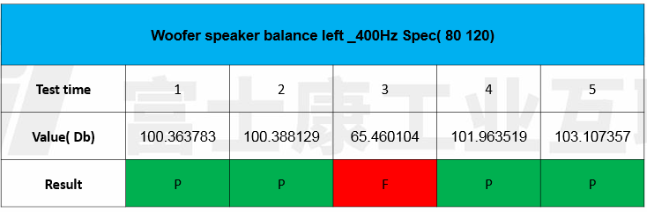
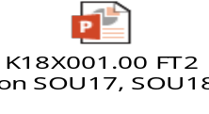
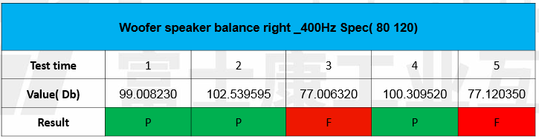
Final Fail Products FA Status-1
2.Final Fail Products FA Status:
Test Station | Fail symptom | QTY | Defect Rate | FA Status | Corrective Action | Owner | Due date | Status
FT2 | SOU017 Woofer speaker balance left_400Hz | 3 | 3% | Step 1: Retest 5 times NG board fail SOU17 with fail value: 77.0925dB ➔ NG board has test result unstable. Pass 4/5 times. Step 2: CPK analysis. - Fail lower than spec value about 69.6451➔ Retest NG board pass normally. | Short term: - Re-assembly ➔ PASS normally - Send FA report for RD: Fu-chiang . Done: 2021/12/24. - Long term: - Co_work with RD: Fu-chiang to improve this issue at FT2 station. | RD: Fu-chiang TE: Allan PE: Michael/ Phuong | TBD | On Going
 | SOU018 Woofer speaker balance right_400Hz | 1 | 1% | Step 1: Retest 5 times NG board fail SOU18 with fail value: 133.440848 dB NG board has test result unstable. Pass 3/5 times. Step 2: CPK analysis. - Fail lower than spec value about 76.4788➔ Retest NG board pass normally. | Short term: - Re-assembly ➔ PASS normally - Send FA report for RD: Fu-chiang . Done: 2021/12/24. - Long term: - Co_work with RD: Fu-chiang to improve this issue at FT2 station. | RD: Fu-chiang TE: Allan PE: Michael/ Phuong | TBD | On Going

Slide 6
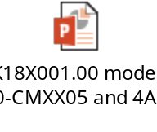
Final Fail Products FA Status-2
2.Final Fail Products FA Status:
Test Station | Fail symptom | QTY | Defect Rate | FA Status | Corrective Action | Owner | Due date | Status
FT2 | SOU004 Full Range Speaker_Frequency Response - 1k Hz | 3 | 3% | Step 1: Open housing VI did not find out abnormal. Step 2: Measure speaker cable 377.00346.005LT find out 2pcs pin 1+2 reversed with pin 3+4, 1pcs pin 2 reversed with pin 3. ➔ Change new speaker cable for NG board. | - Feedback with SQE and send FA analysis. Done: 2021/12/17. - Continue feedback with SQE q’ty fail of speaker cables on MO control run. - Waiting DREAMUS feedback and improve this issue. | SQE: Tuan PE: Nam | TBD | On Going
Summary:
- All issue at FT2 station unrelated 5R67, 5R68 to solve audio noise issue.

Slide 7
Conclusion
The final test yield rate is : 93%.
Base on test FATP and power on/off 50 times : Don’t find out any product function fail related to 5R67, 5R68 and audio noise issue.
As control run result, Factory will keep monitoring about 200pcs power on/off, if don’t find out audio noise issue at power on/off station of MP. Can remove Power on /off.

